Slide 1
General Practices
Procedures should not be prefixed with “sp”. sp_ prefix makes SQL Server look at the
master database for a compiled plan. And if it is not found it will recompile.
Procedures should be named according to business function.
Particulars | Numbers
Total Procedures | 7754
Procedures with “usp” starting | 5794
Procedures with “SP” starting | 20
Procedures without sp or usp | 1940
For Eg… DailyTimeSheet……

Slide 2
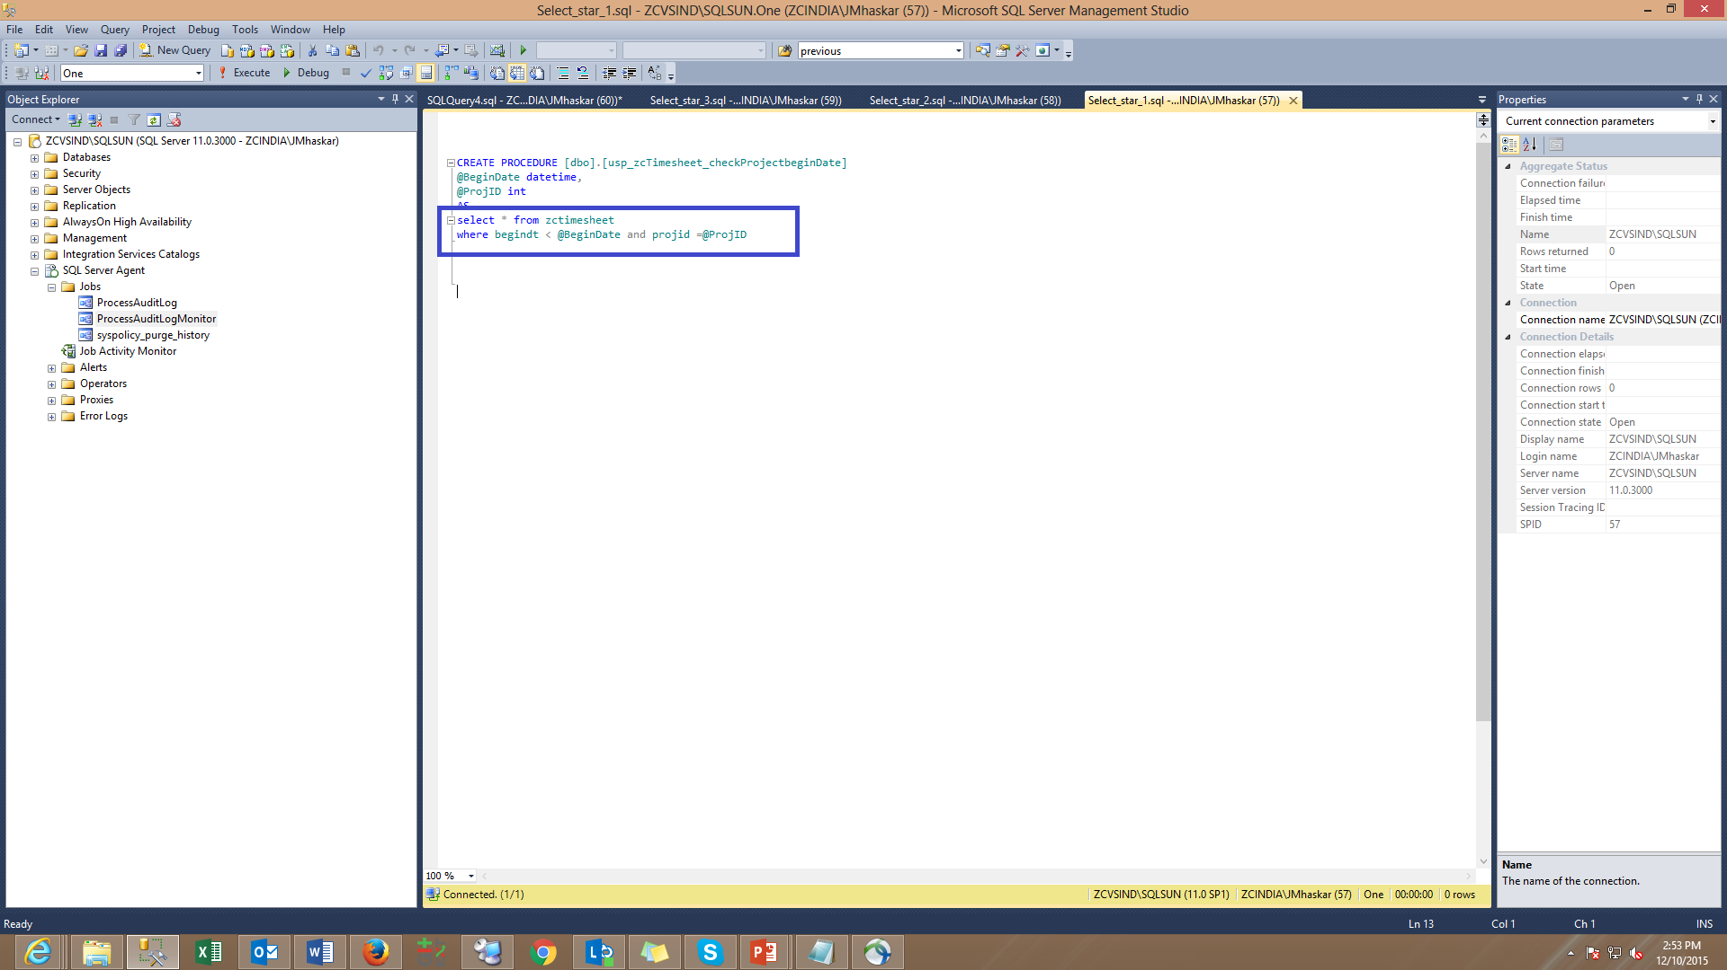
General Practices
Avoid using “select *” in stored procedures. Instead list column names that are required.

Slide 3
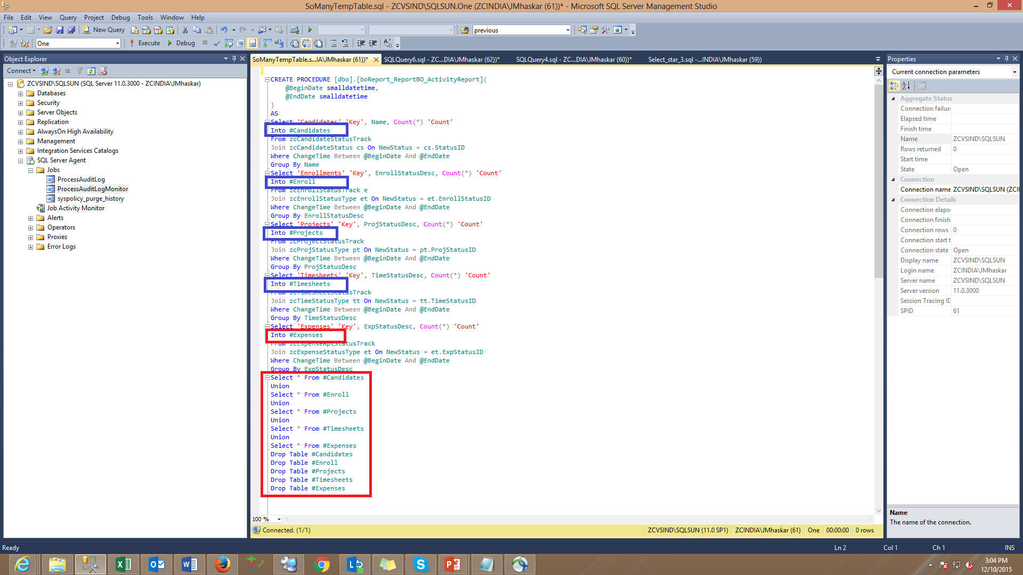
Procedures Standards
Avoid unnecessary creation of temporary tables, though small they take some place in tempdb.
This could have avoided by including union all during the data generation itself.

Slide 4
Procedures Standards
General Practices
Each Procedure should have the following, which is currently missing in many of the Stored Procedures
SET NOCOUNT ON
Stops the message that shows the count of the number of rows affected by a Transact-SQL statement or stored procedure from being returned as part of the result set. For big procedures this surely affect performance.
SET ANSI NULLS ON (SET ANSI NULLS OFF would be deprecated in future versions of SQL Server).
SET XACT_ABORT ON (IF Error handling is not done with Begin Try / End Try)
OFF : Indicates that only the Transact-SQL statement that raised the error is rolled back and the transaction continues.
Other side effect is that a cancel/timeout error can leave an open transaction
ON : Instructs SQL Server to rollback the entire transaction and abort the batch when a run-time error occurs.
Avoid using Large Text Data Type
Avoid using text, ntext datatypes for storing larger textual data. “Text” datatype has some inherent problems associated with it. You cannot directly write, update text data using INSERT, UPDATE statements, you have to use special statements like READTEXT, WRITETEXT AND UPDATETEXT. Instead use NVARCHAR(MAX), VARCHAR(MAX)

Slide 5
Procedures Standards
Error Handling
Proper Error handling should be done in procedures to ensure integrity. Below is the statistics for current database state
Begin Try
< Code To Execute >
End Try
Begin Catch
<Handling Error Message>
End Catch

Slide 6
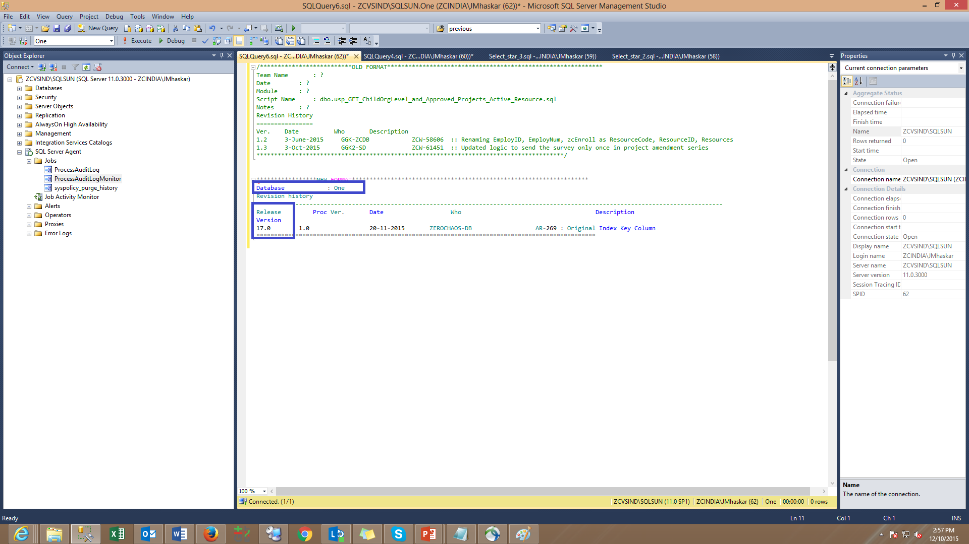
Procedures Standards
Revision History
There are many procedures in the system which either don’t have revision history at all or they are not updated. The following revision history format helps us while debugging the procedure.

Slide 7
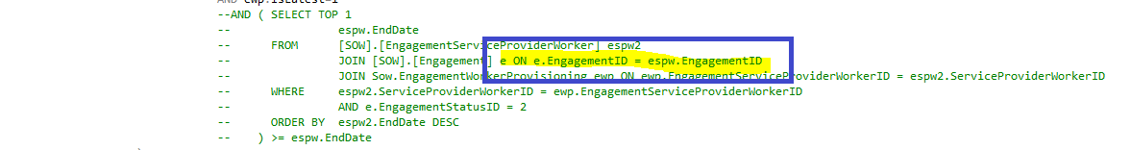
Procedures Standards
Be sure of Table Aliases
Take care while giving aliases to tables and then joining them on common key column. Sometime wrong aliases don’t give error but then they become performance victim.
In above example alias for engagementid should have been espw2 instead of espw. It don’t give error becauase espw has already been defined on outer query, but with this either result sets are wrong or if there are large datasets then there can be performance issue.

Slide 8
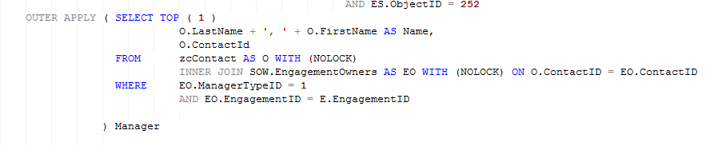
Procedures Standards
Avoid Outer Apply
Wherever possible avoid outer apply , unnecessary scans are generated with outer apply. Instead make a use of Left Join.

Slide 9
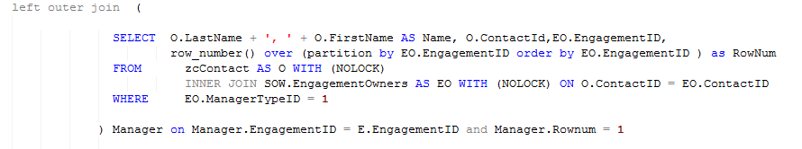
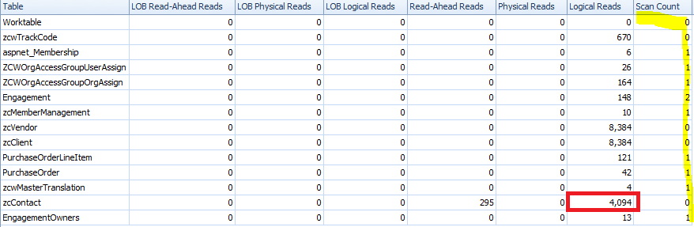
Procedures Standards
Avoid Outer Apply
One can see that when Left join was used, Scans are gone and it has also decreased the Logical read for Zccontact table.
For outer apply total logical reads for zccontact table was 6384 and with left join they are decreased to 4094.

Slide 10
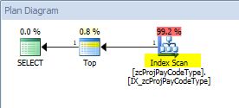
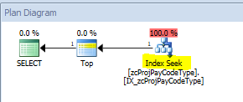
Procedures Standards
Avoid SQL Functions in Where Clause
Whenever not necessary and possible avoid writing sql function in where clause, because it will go in scan rather than seek.
Below query is executed without SQL Function

Slide 11
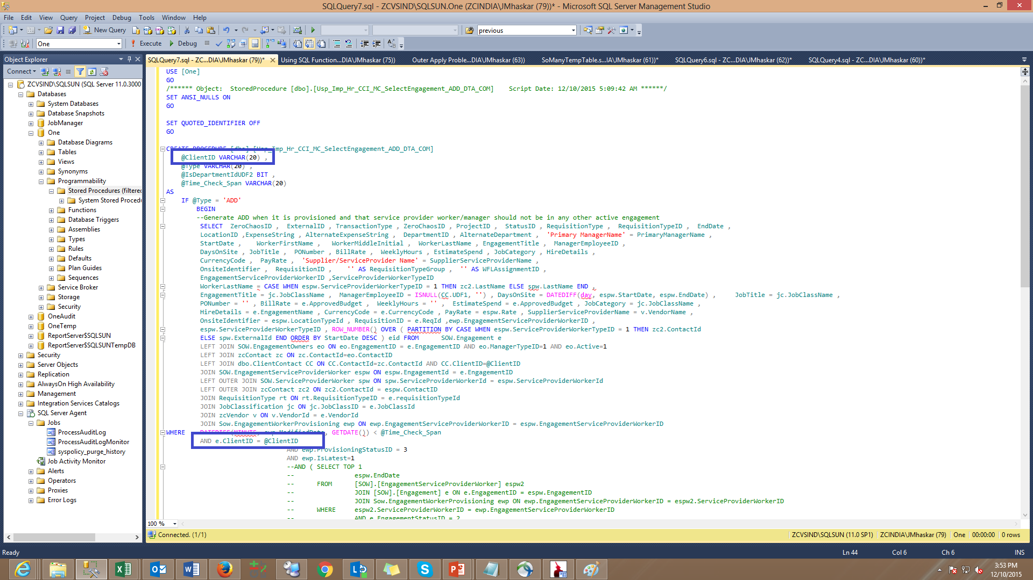
Procedures Standards
Avoid wrong datatype as input parameters
Avoid using wrong data type while defining input parameters for stored procedures
In above example data type for @Clientid is defined as Varchar(20), and then it is equated with DIVISIONRESOURCE table, in division resource table clientdi is of type INT. This goes in unnecessary Implicit Conversion.

Slide 12
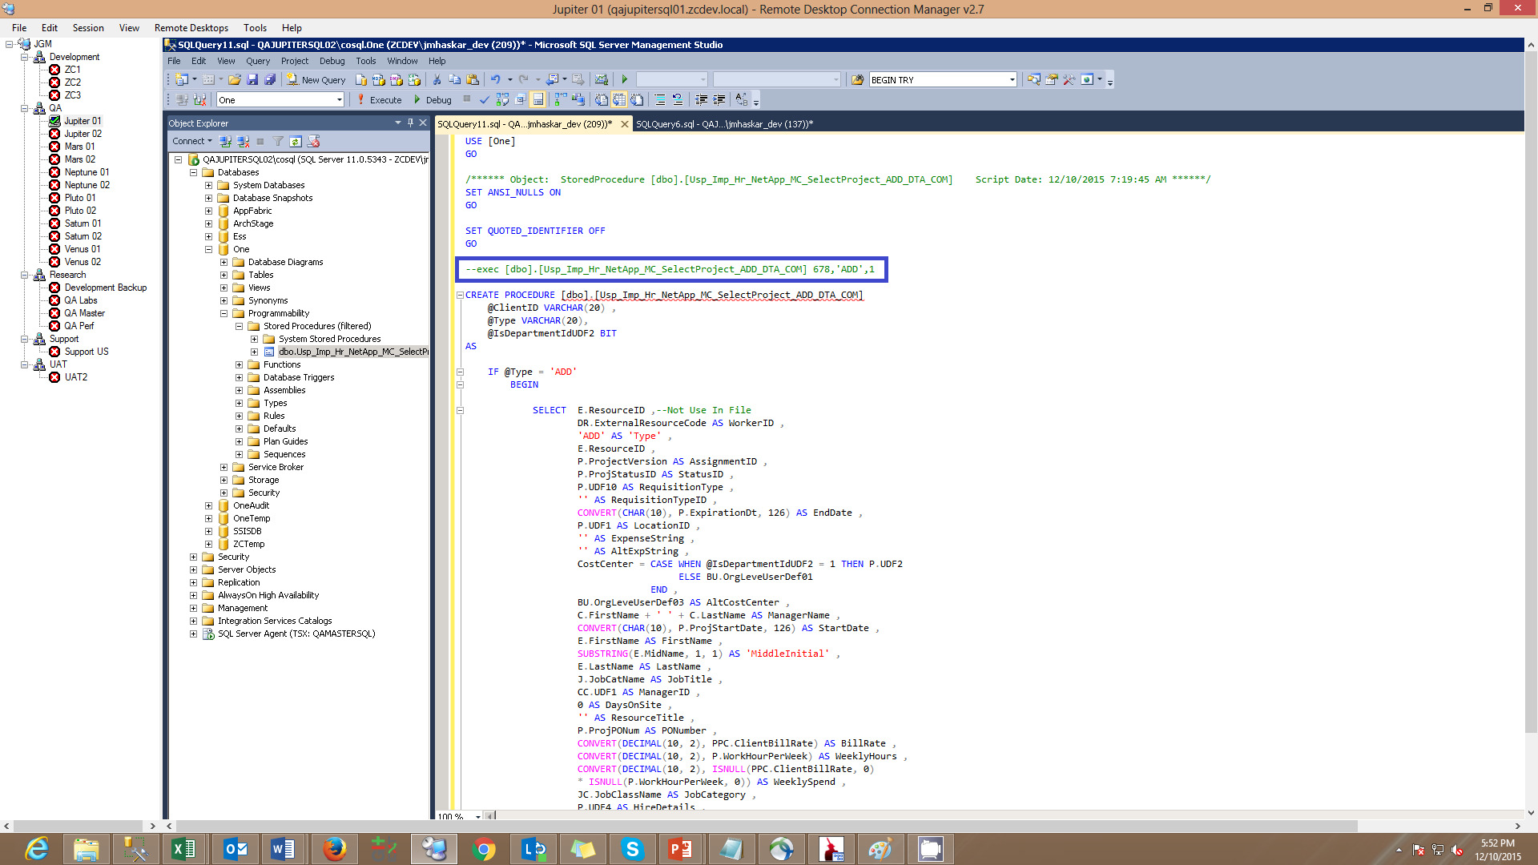
Procedures Standards
Input Parameter Values - Recommendation
Whenever procedure is created user should put Commented Executable statement with all Input Parameters, which is very helpful in fast debugging.

Slide 13
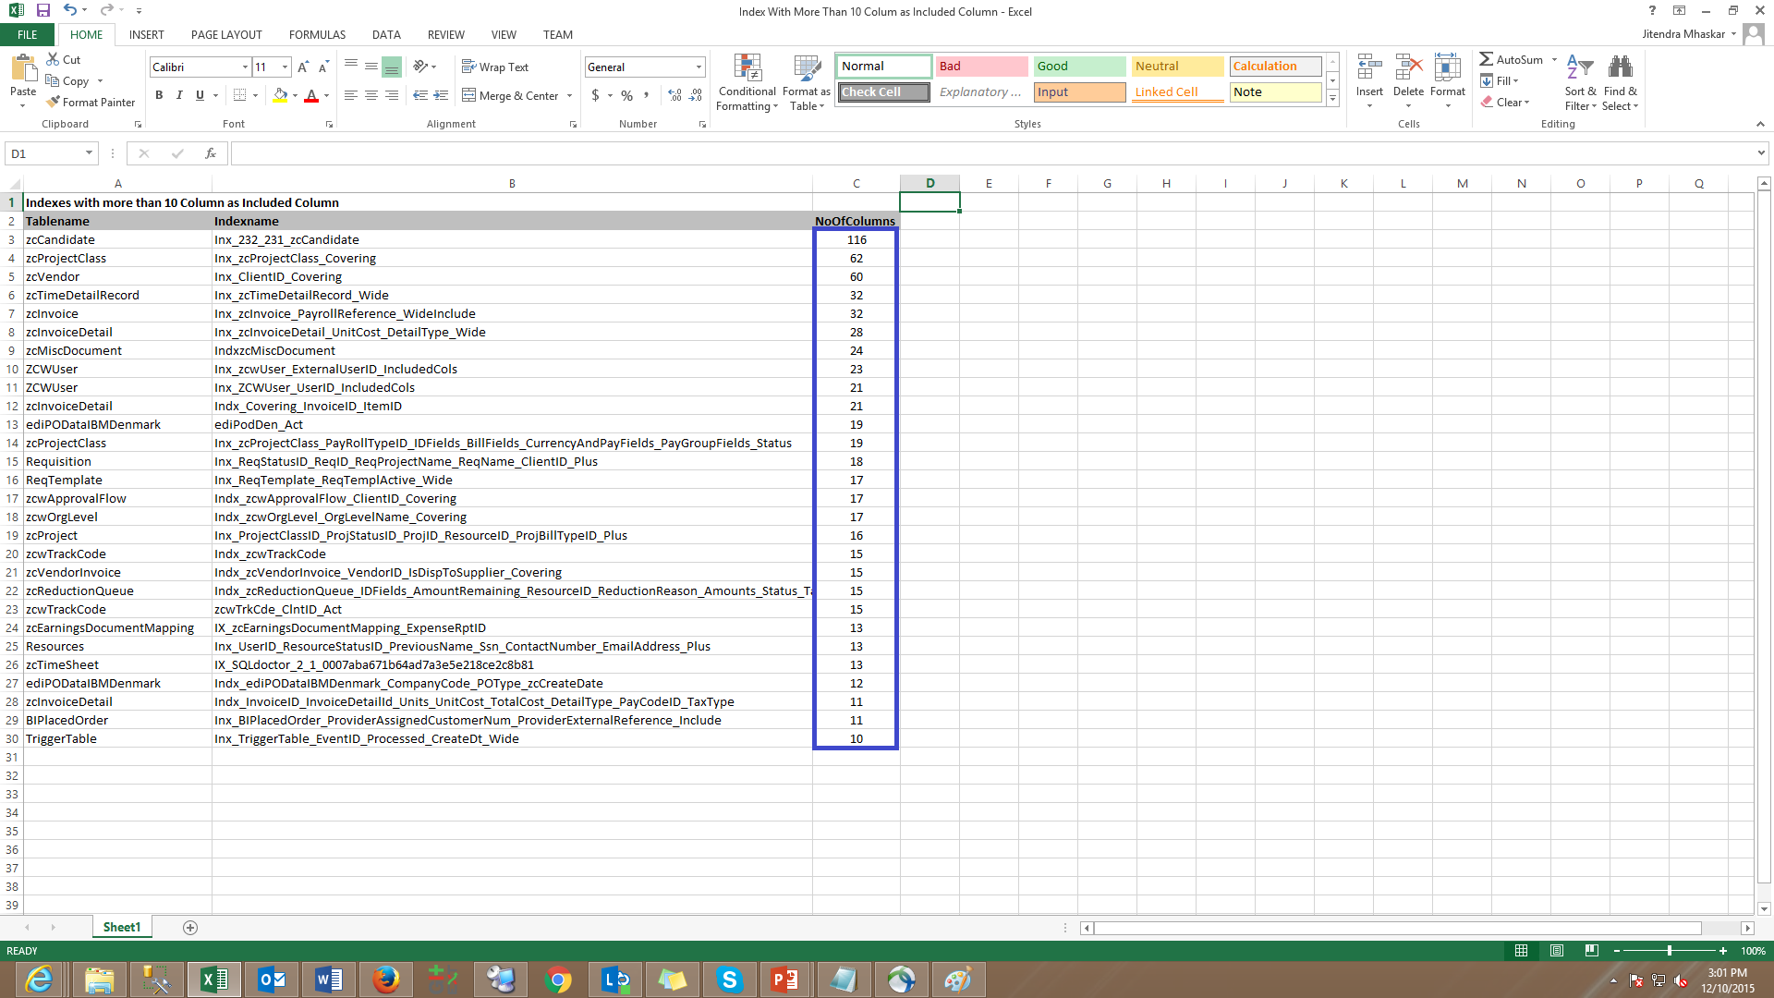
Index Maintenance
There are indexes on tables which have huge number of included columns on it.

Slide 14
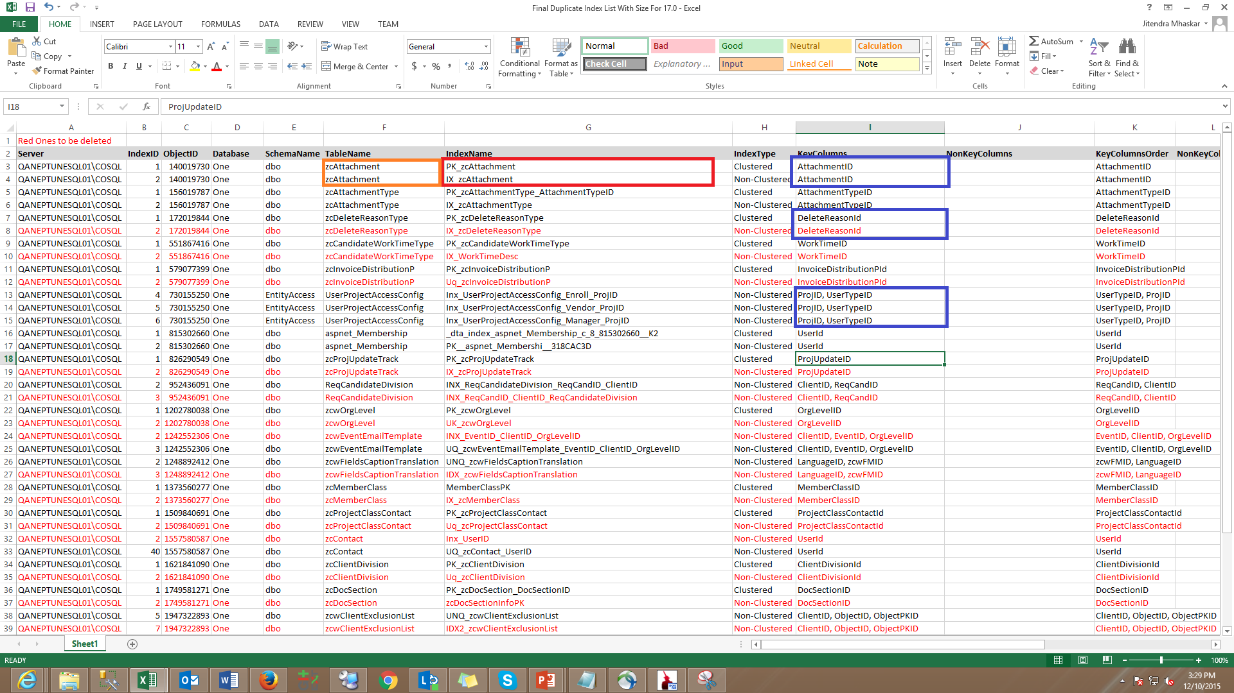
Index Maintenance
There are various indexes which are duplicate in terms of key columns in it. So before requesting any index, please
get the statistics of existing indexes on table. All the indexes would be created by data team.

Slide 15
Index Naming Standards
Data team has created Index Naming standards as follows, henceforward the same will be used while creating New Indexes.
We will be renaming all the current indexes with 17.0 release.
1 | PKCX | Primary Key Clustered Index
2 | PKNC | Primary Key Non Clustered Index
3 | CX | Clustered Index with Single Key Column , without any included columns
4 | NC | Non clustered Index with Single Key Column, with or without any included columns
5 | CVCX | Covering Clustered Index, with more than 1 key column and without included columns
6 | CVNC | Covering Non Clustered Index, with more than 1 key column and without included columns
7 | FLCX | Filtered Clustered Index
8 | FLNC | Filtered Non Clustered Index
9 | CS | Column store indexes
Type of Index Column
K - Key Column
I - Included Column
So Typical Index would look like below
<Type of Index>_<TableName>_< COL1 (Type Of Index Column ) > _ < Col2 (Type Of Index Column)

Slide 16
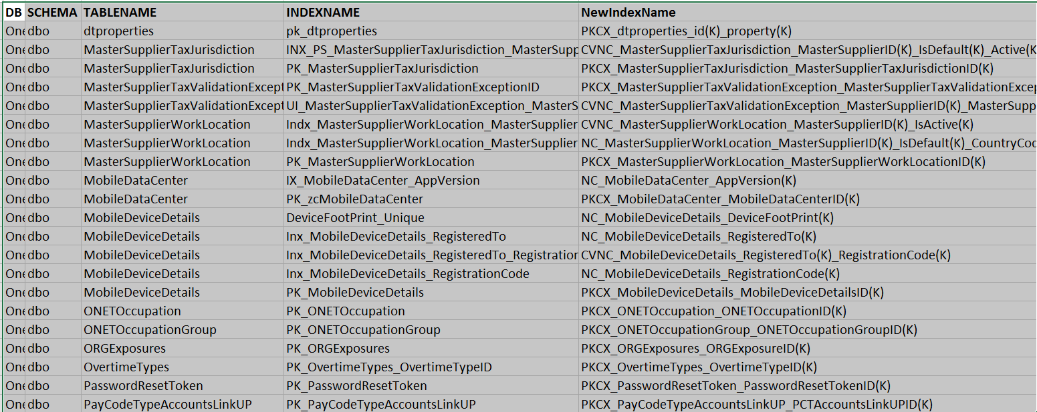
Index Naming Standards
Some Example of Old Name and New Name

Slide 17
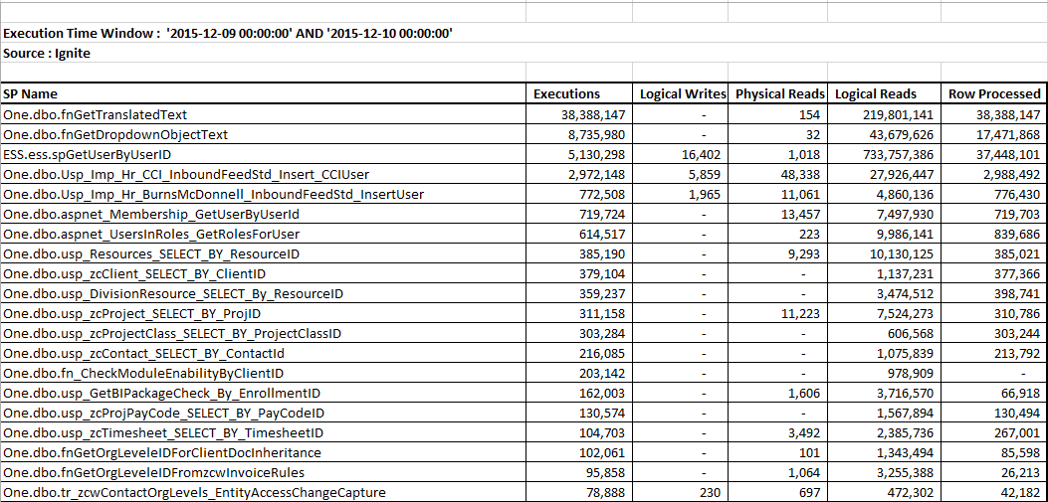
Top 20 SP Executions
Improvement : Asp.net & SQL Cache dependency
Reference : https://msdn.microsoft.com/en-us/library/ms178604.aspx

Slide 18
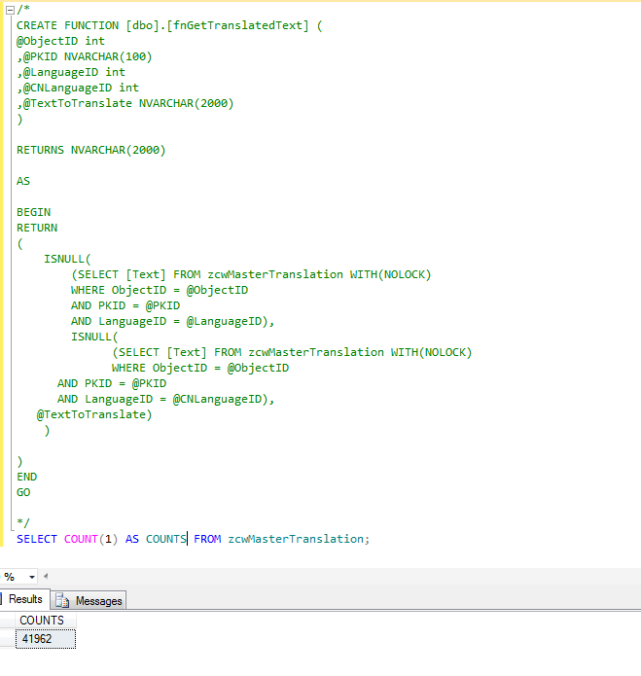
Top SP Executions

Slide 19
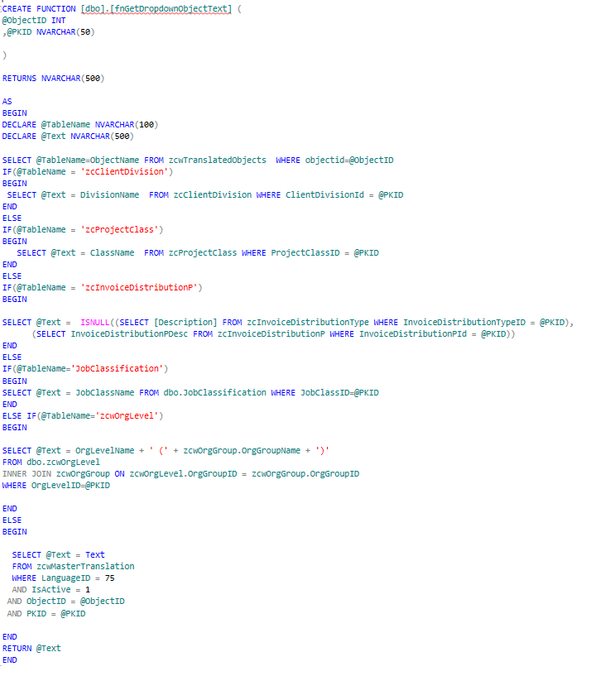
Top SP Executions

Slide 20
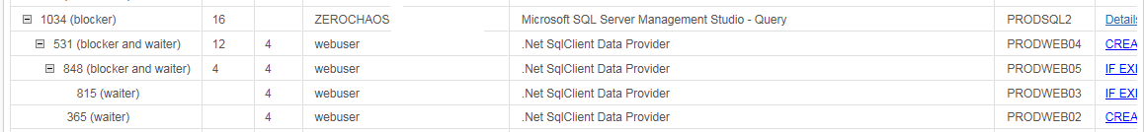
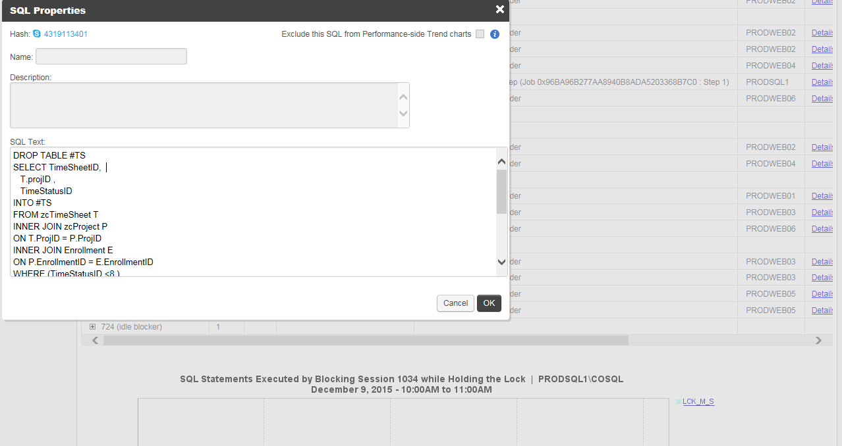
Idle Blockers
User should close SSMS sessions when they are not using / needed, otherwise it is unnecessary goes to
open state and consume bit resources.

